Slide 1

IPL DATA ANALYSIS AND VISUALIZATION
Quad Squad:
Sangeetha R Achyuth A Sukumar B Nikhitha B
Under the guidance of prof. Syed Jawad Hussain Shah

Slide 2

Introduction
The Indian Premier League (IPL) is a professional men’s Twenty20 cricket league in which 10 teams compete from ten different locations.
Over the years, the league has attracted top players from around the world and has become a major event in the cricketing world.
Data Collection and Data Analysis in IPL has breached the next level, it has become necessary for IPL teams to find out that, “Should they spend on a particular player or not?” or “How valuable is the player going to be for the team?”

Slide 3

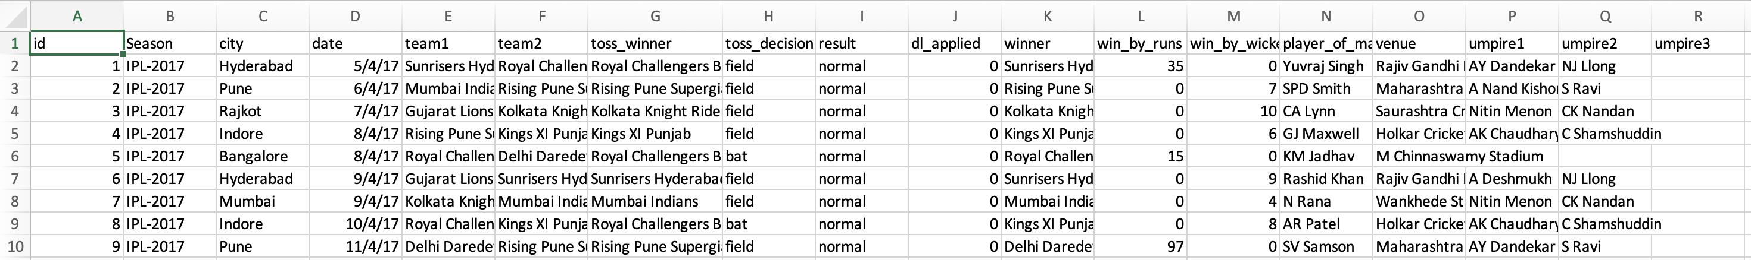
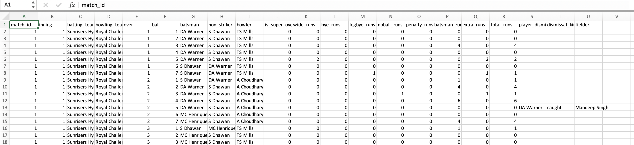
Dataset
Collected From: CricSheet.org
IPL T20 Official website
Matches.csv - Match by Match data of 2008-2019
deliveries.csv - Ball by ball data from 2008 – 2019

Slide 4

Tools Used
Operating system: Windows
Coding language: Python
Tool: Google Data Studio
Packages: Matplotlib, Seaborn, Pandas, numpy, math, accuracy_score, train_test_split, sklearn, LabelEncoder, norm, scipy, inline, stats, sqrt,etc.,

Slide 5

Project Flow
Data collection
Data Preprocessing
Data Analysis
Data Exploration
Data Visualization
Prediction
Algorithms
Data Training

Slide 6

Data Preprocessing
Converting names of the teams
Dropping unnecessary columns
One Hot encoding of toss decision, method and eliminator
Checking null values and replacing them
Describing the dataset’s feature columns and analyzing each feature.
Performed several feature engineering techniques in order to make the dataset suitable for making the model. Encoding for converting categorical features to numerical features and techniques to avoid null values are used.

Slide 7
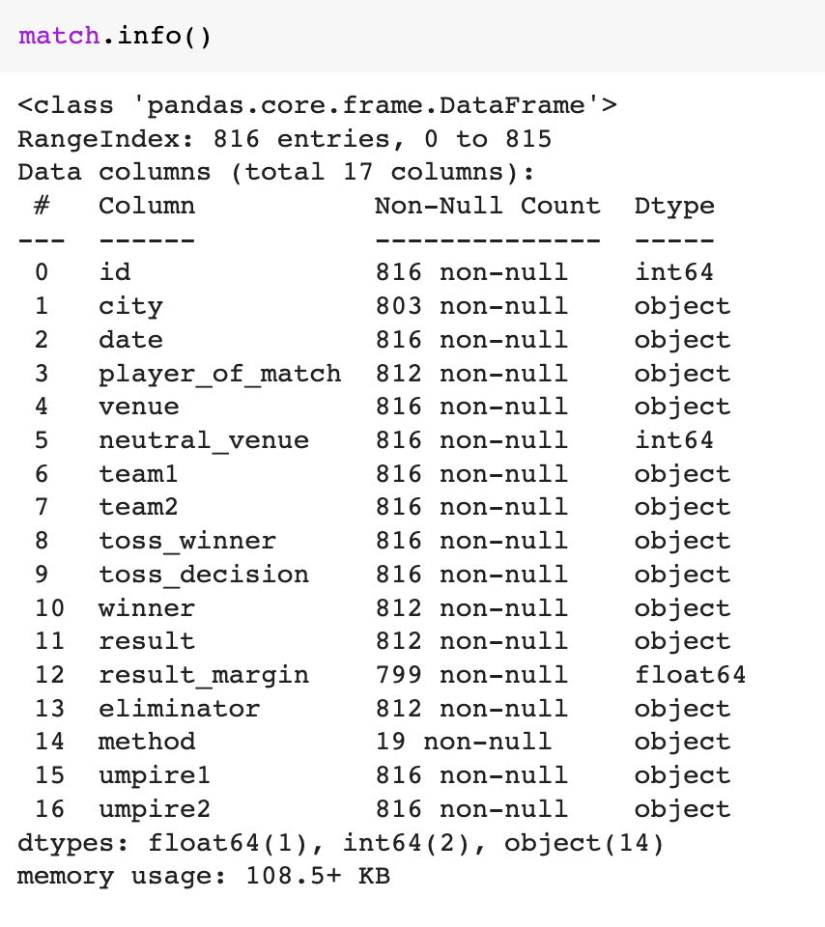
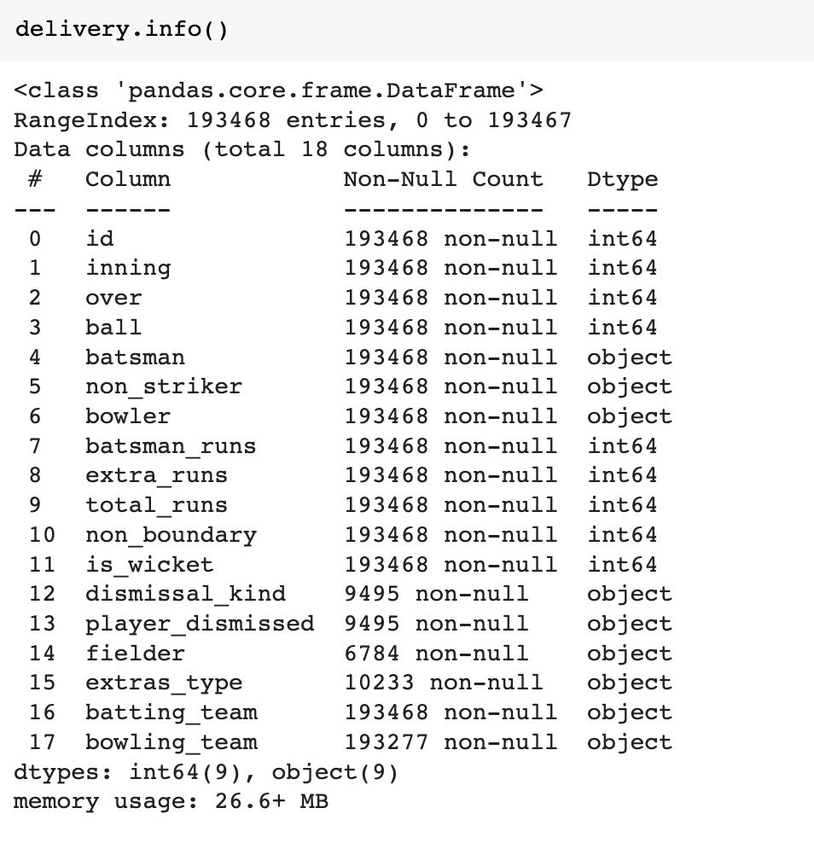

Data Analysis
This analysis includes checking for null values and replacing them, describing the dataset’s feature columns, and analyzing each feature.

Slide 8
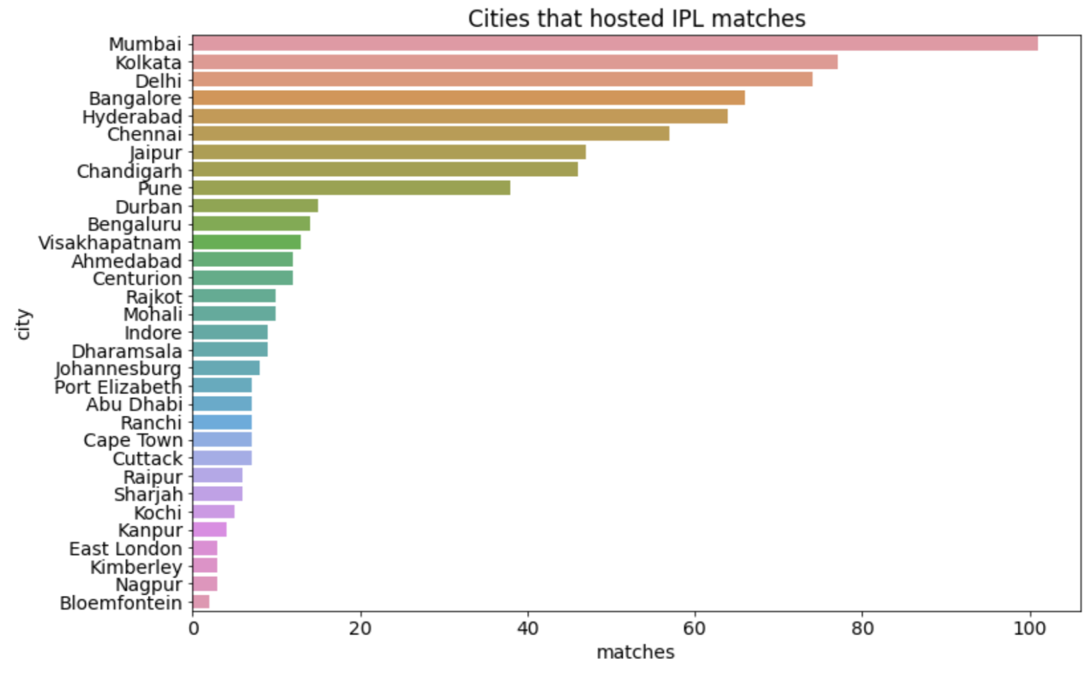
Data Visualization
Done a graphical representation of the dataset in order to get an understanding of the teams, matches and the toss decision of the IPL Matches

Slide 9
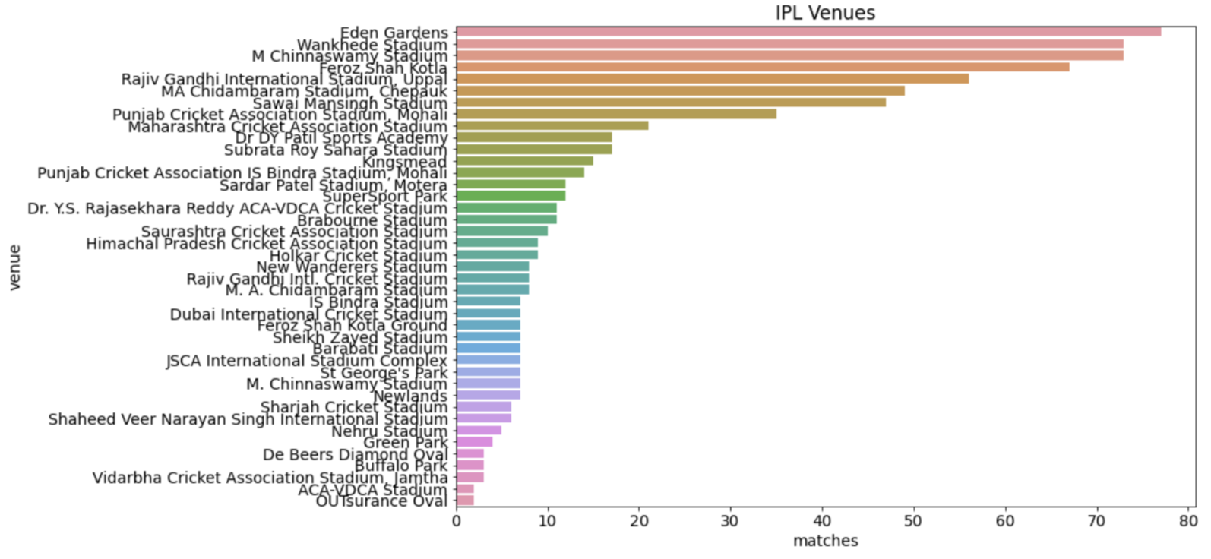
The venue that hosted the maximum number of matches
Notes:
MATCHES PLAYED

Slide 10
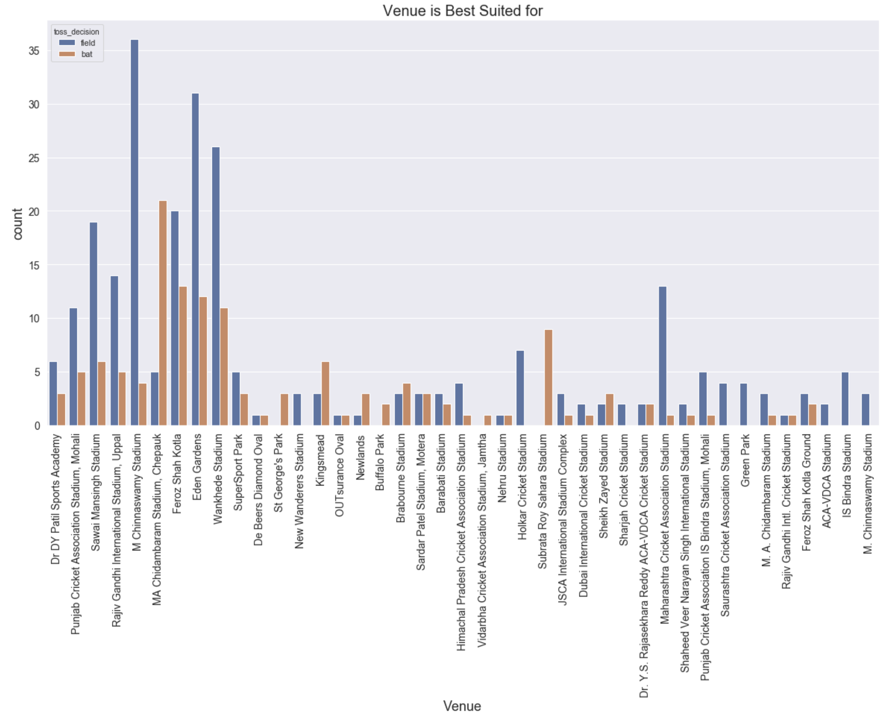
Notes:
MATCHES PLAYED

Slide 11
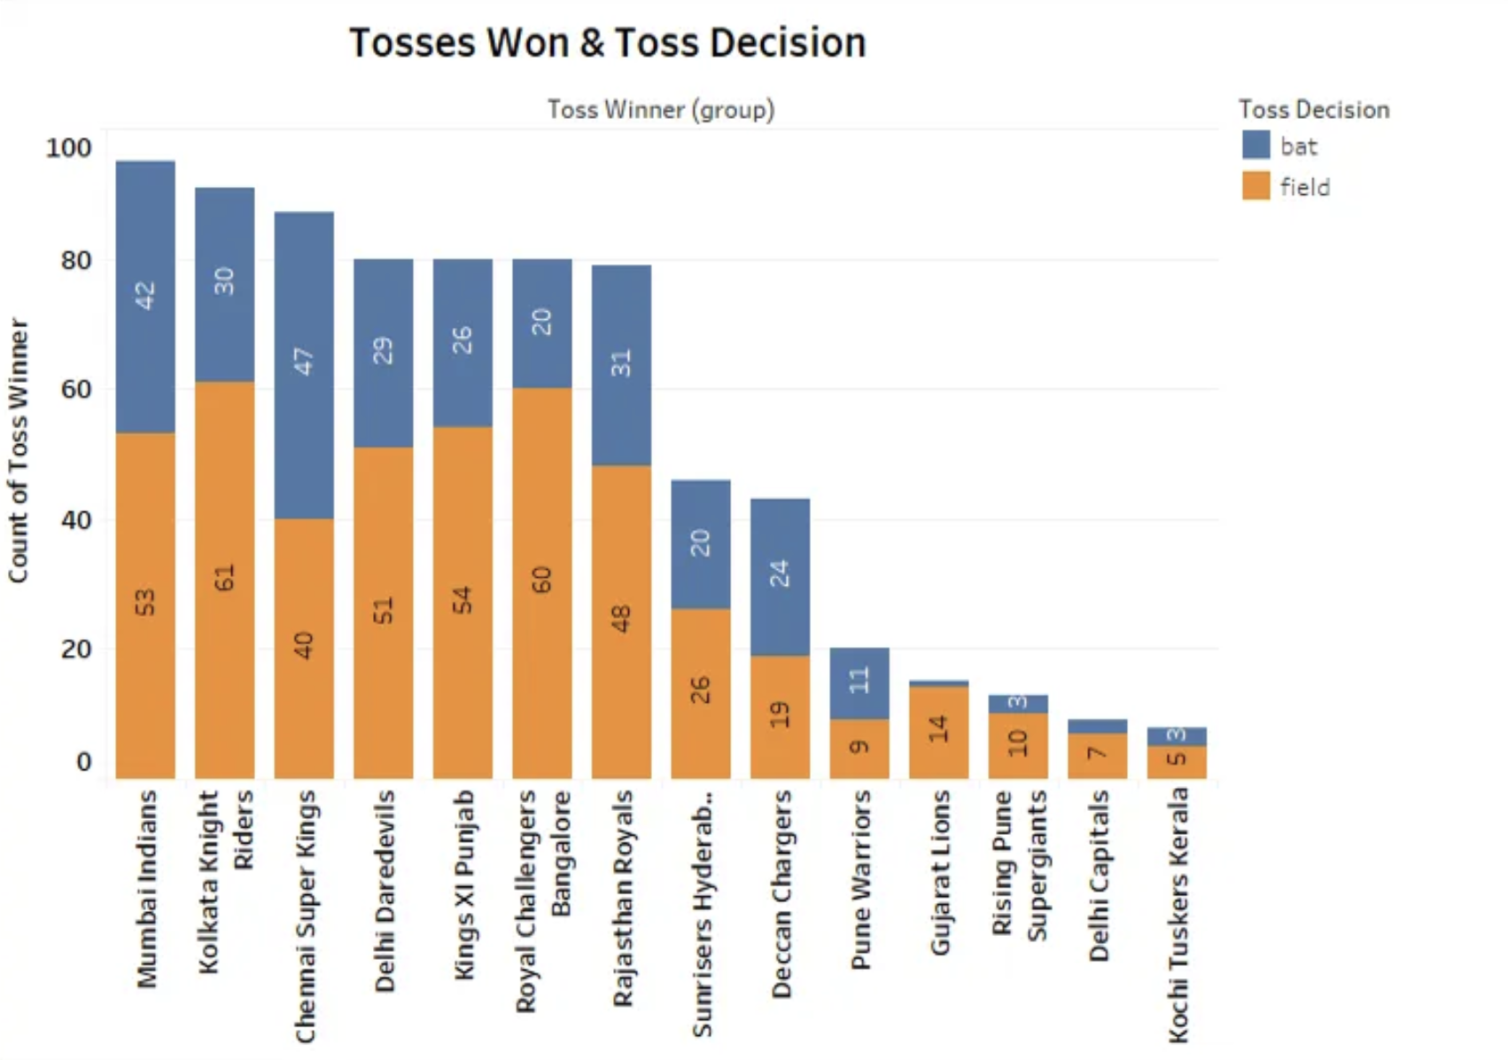

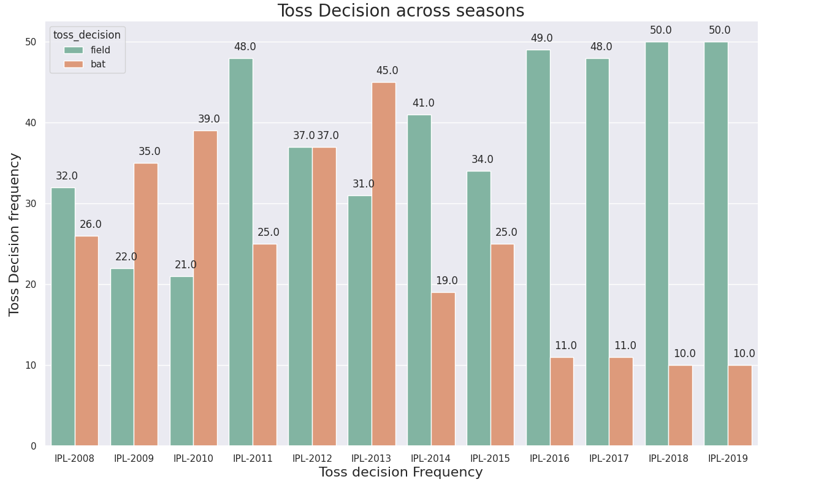
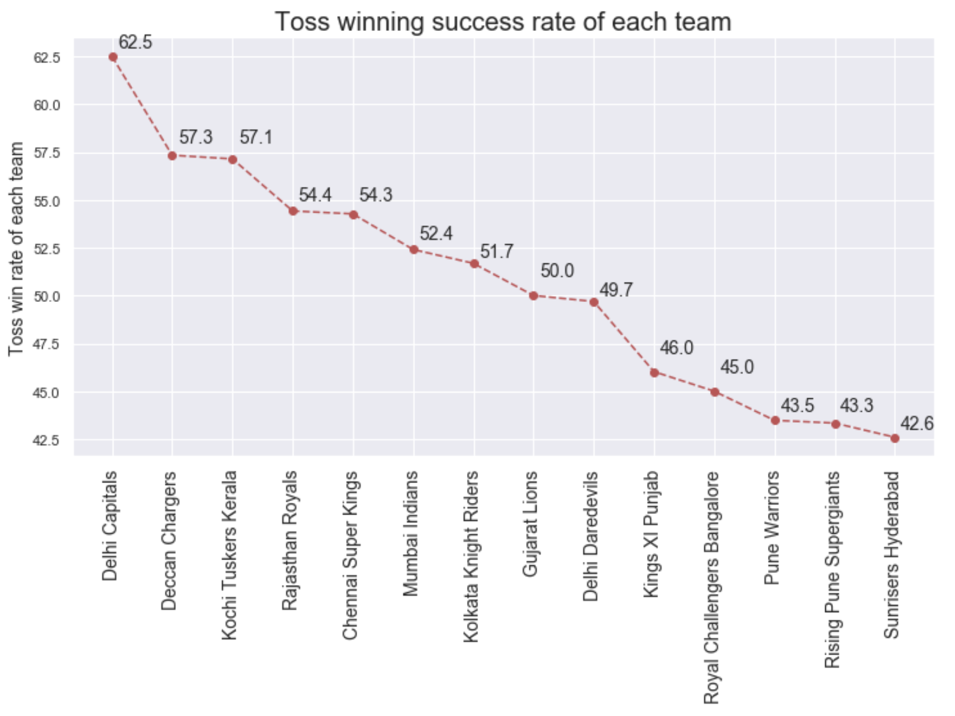
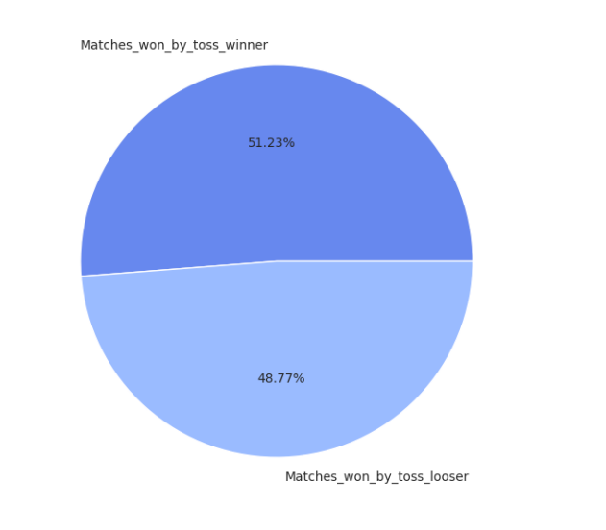

Slide 12
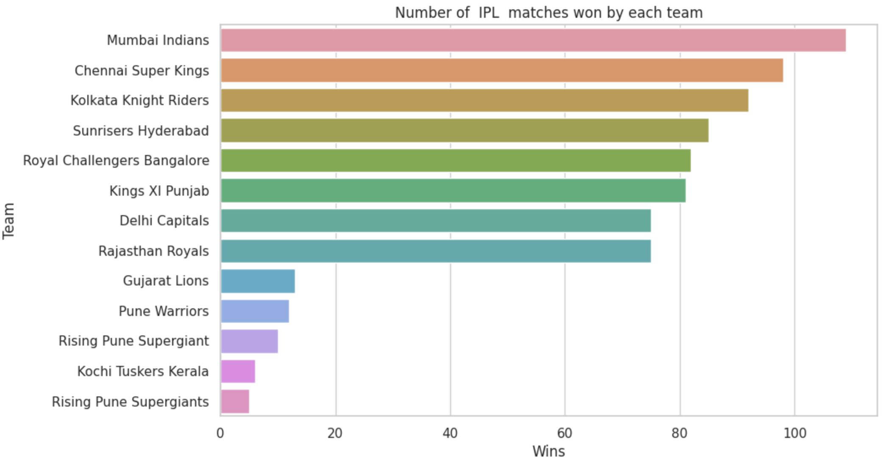

Slide 13
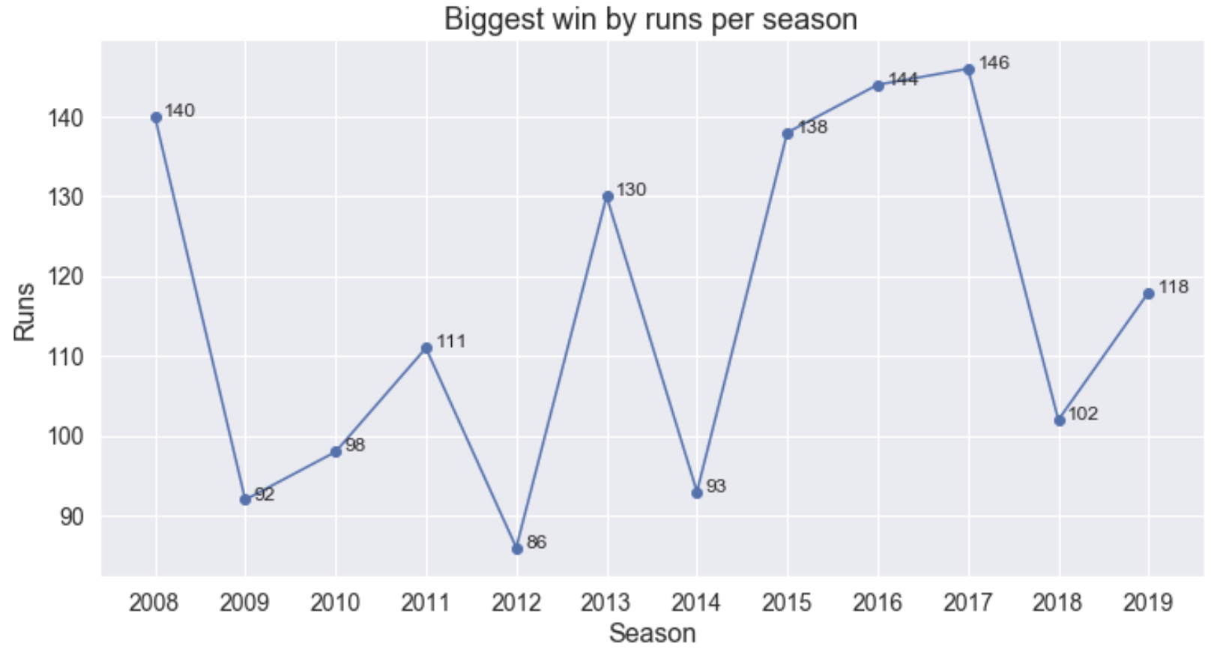
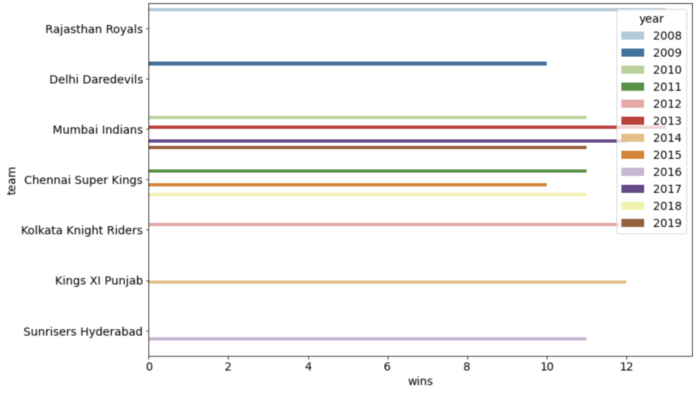
The team with the most number of wins per season.

Slide 14
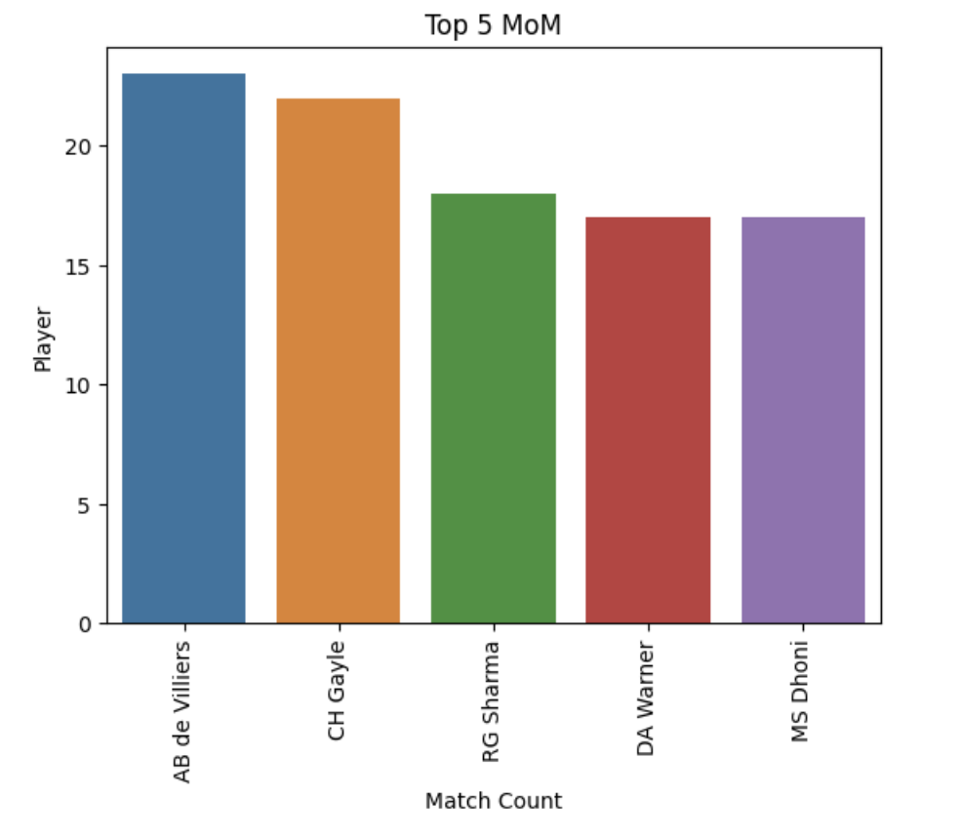
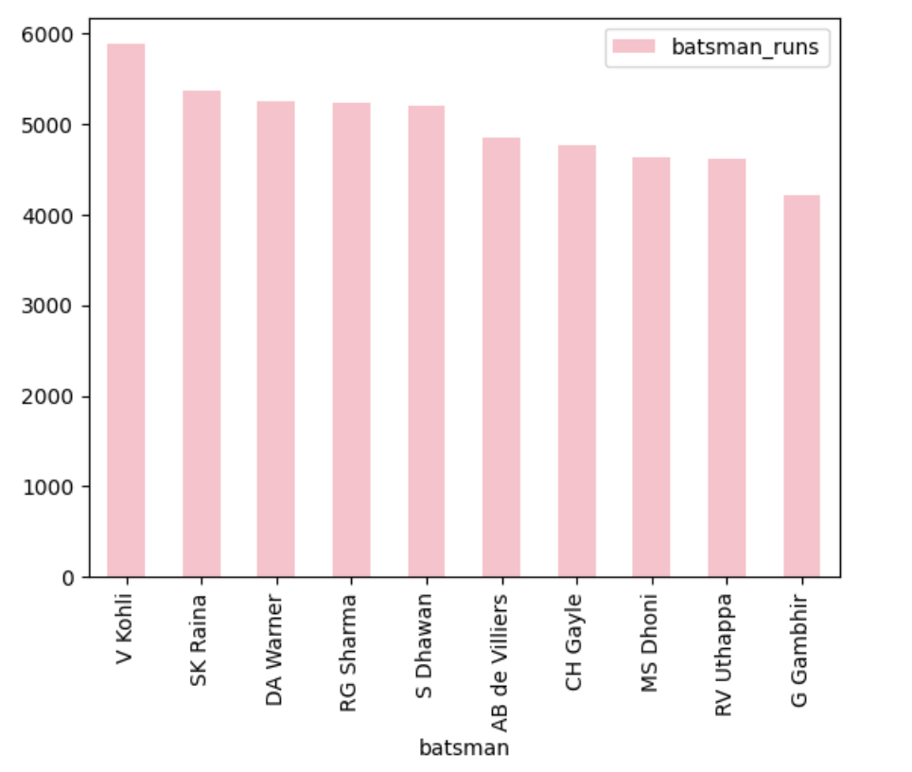

Top batsman

Slide 15
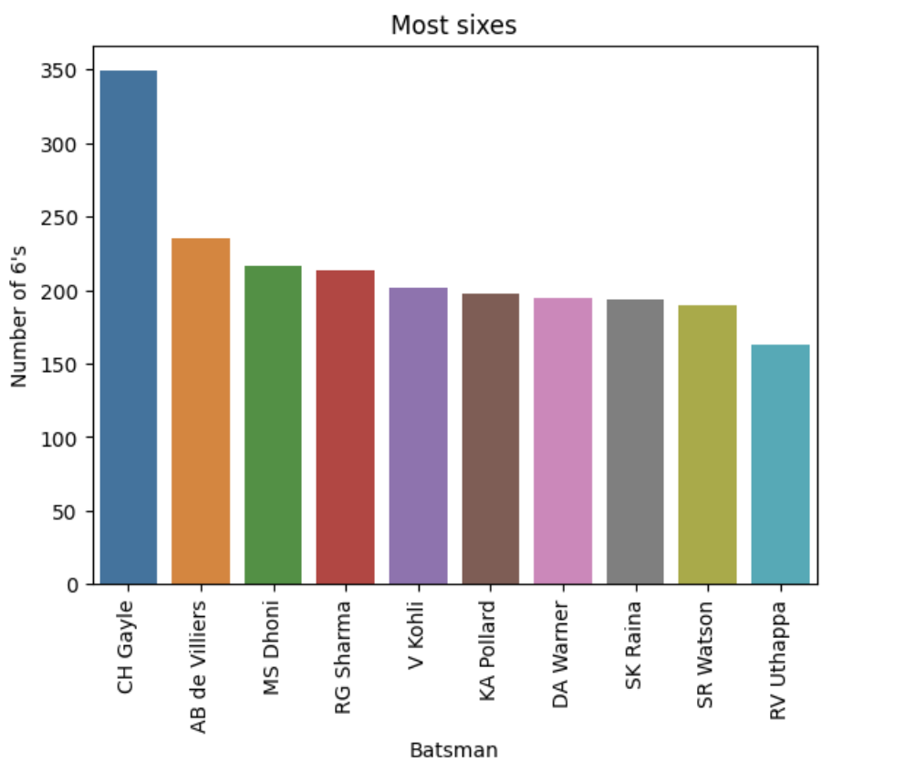
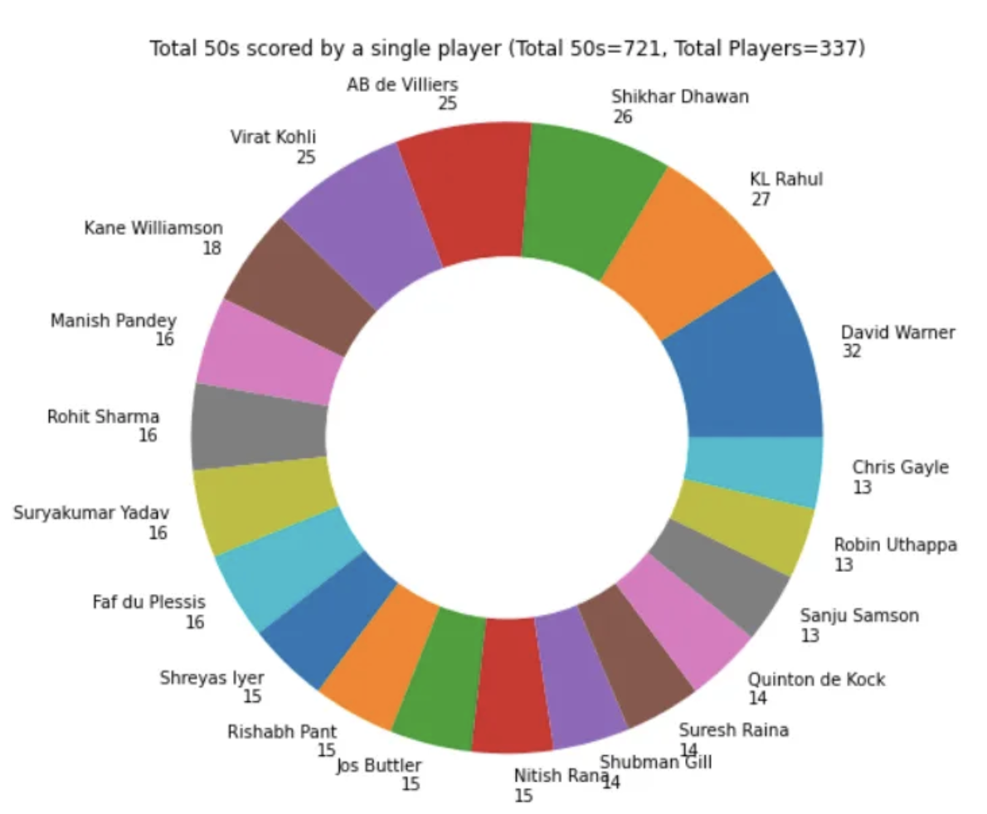


Slide 16
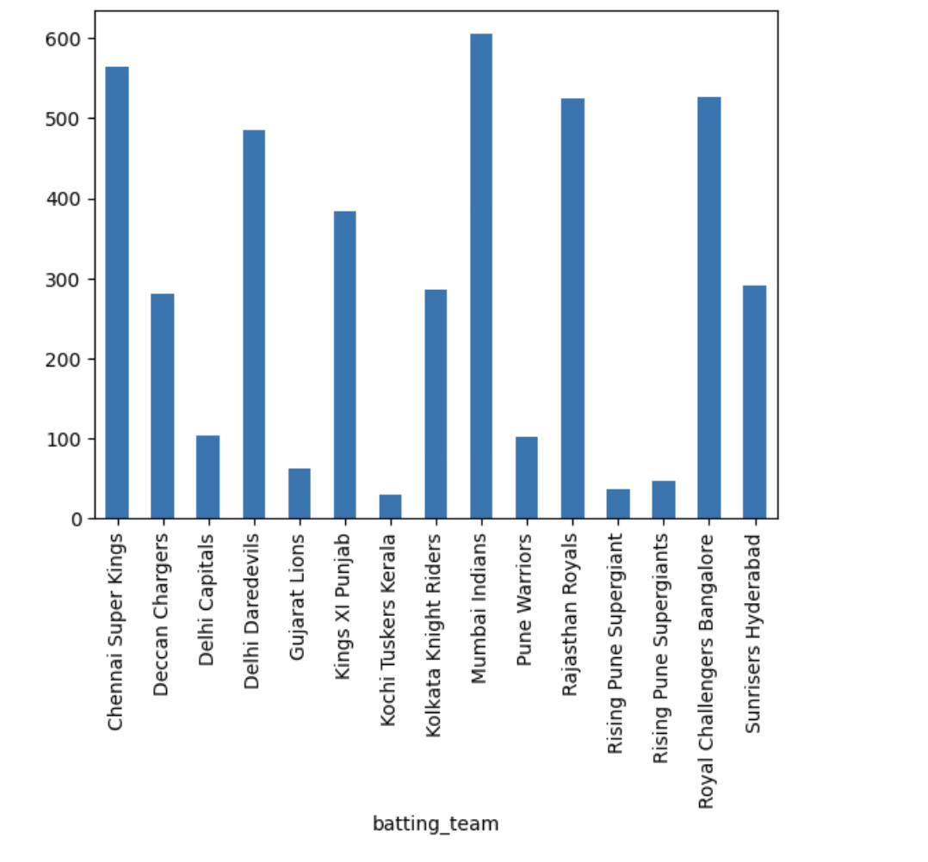

The Bowler with Team-wise Performance
Notes:
MATCHES PLAYED

Slide 17
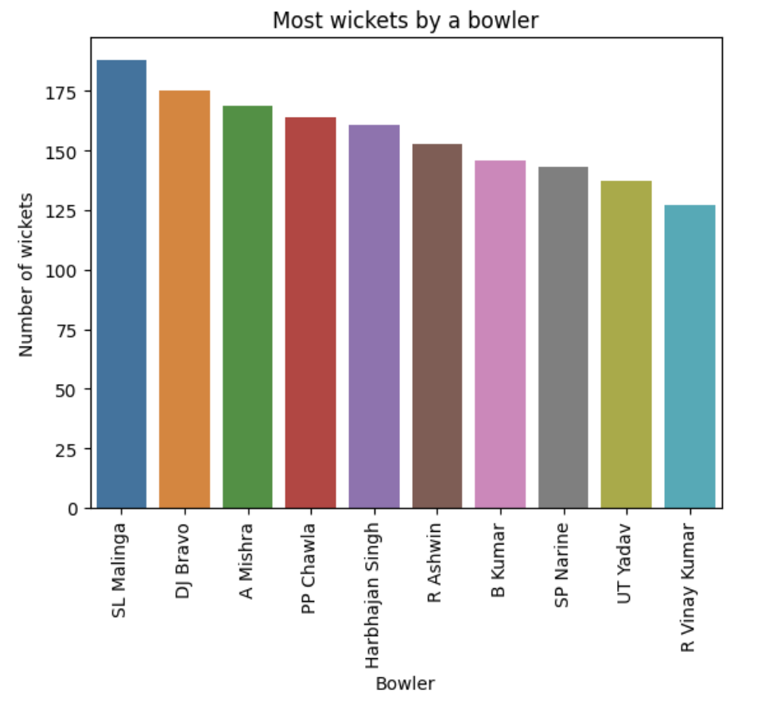


Slide 18

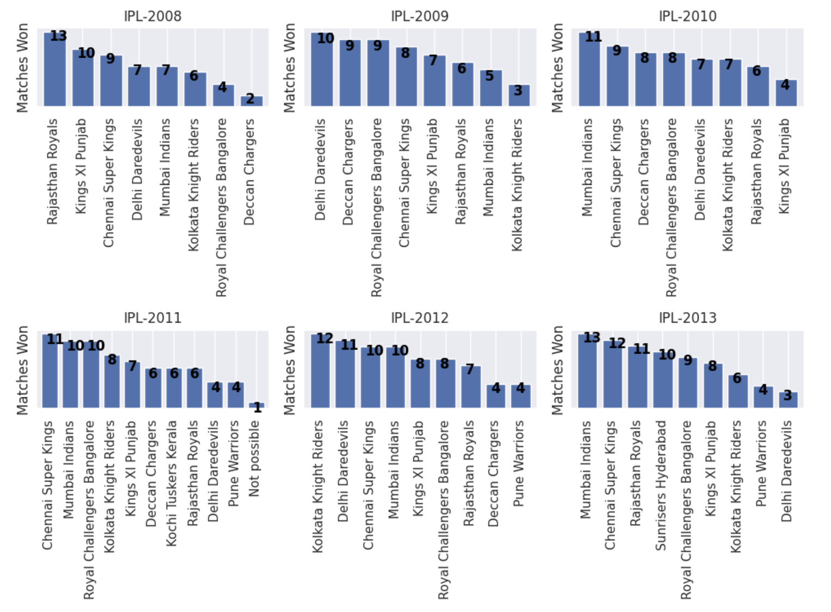

Slide 19
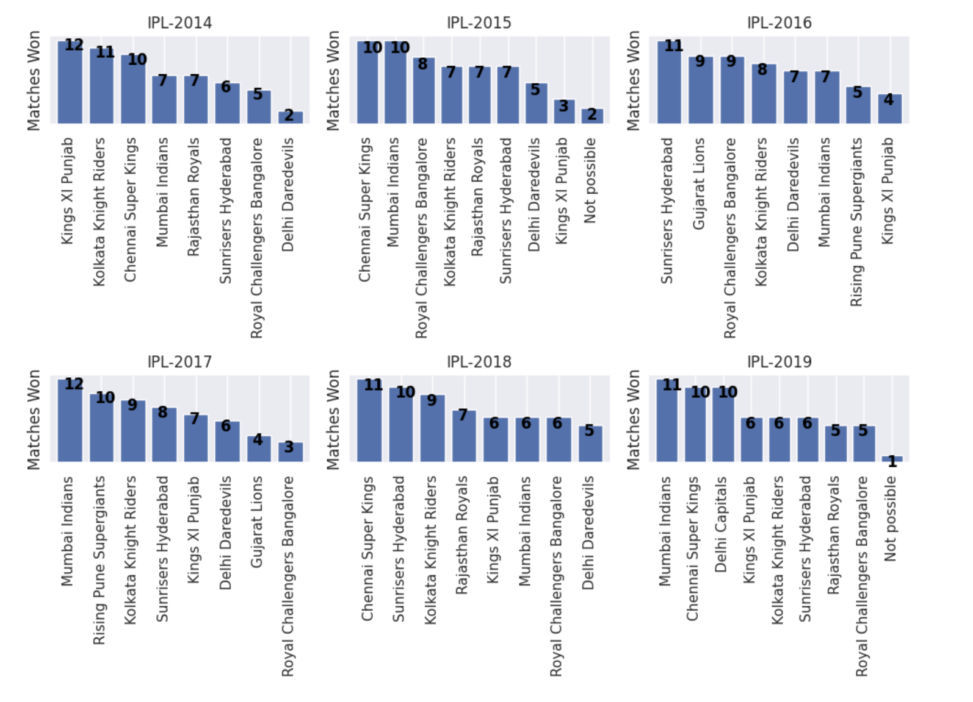


Slide 20
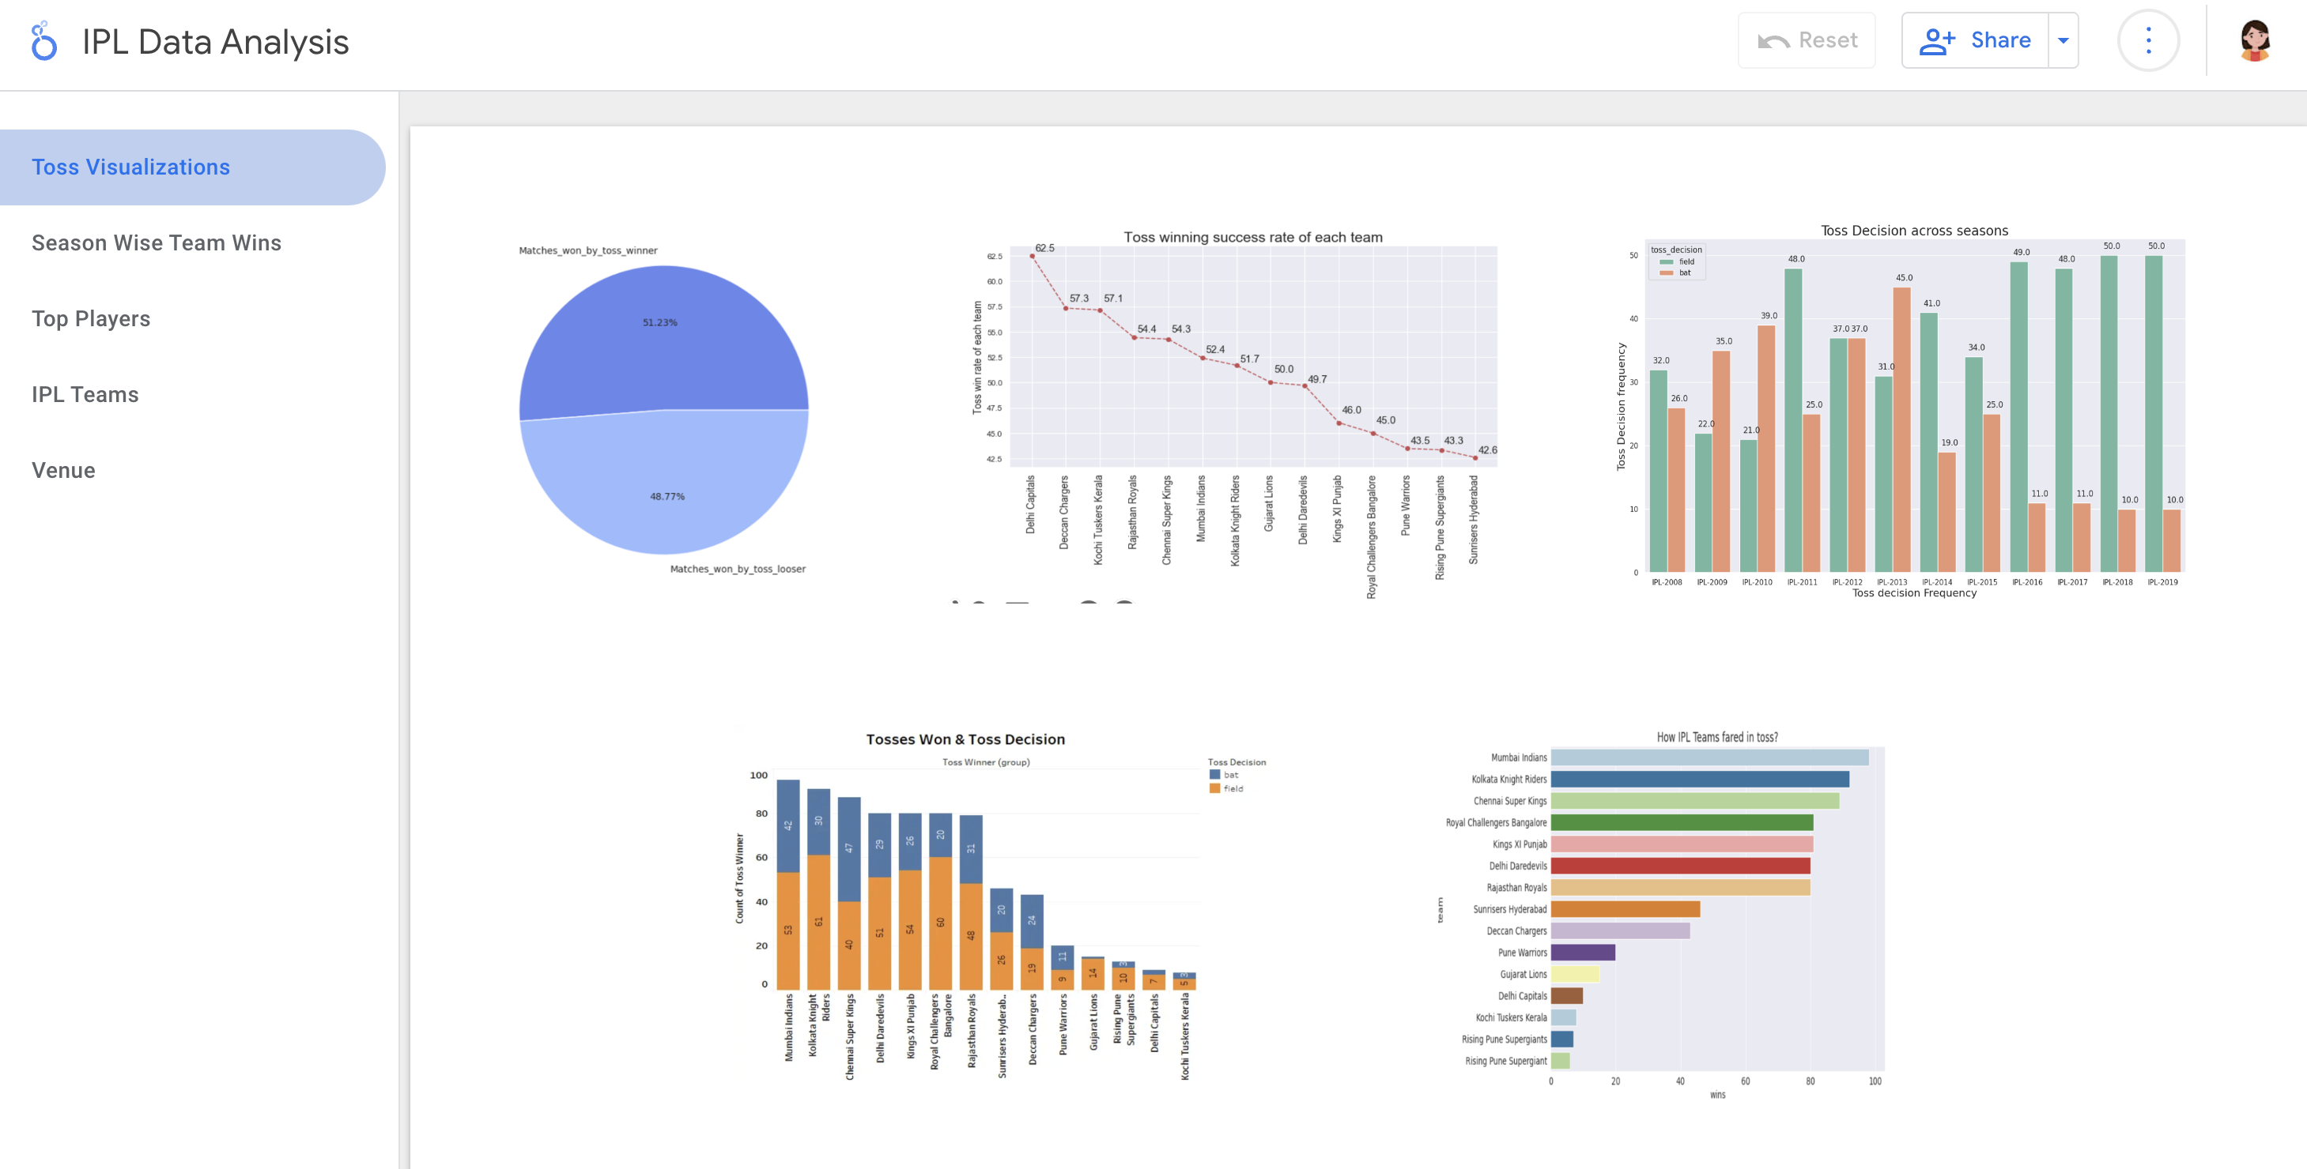


Slide 21

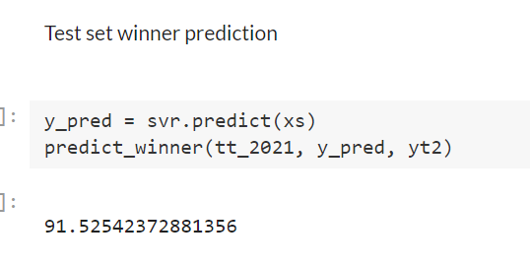
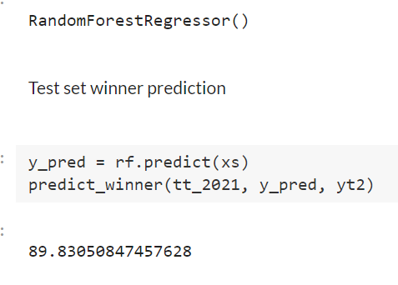
Predictions
Approach | RF | SVR
Runs Prediction | 25.14 | 30.4
Ball by ball (1-10) | 35.294 | 29.4117
Ball by ball (11-20) | 33.33 | 83.33
Trained on 11-20 overs | 56.16 | 79.34
Trained on 11-20 overs-Remove some biased factors | 71.0 | 81.1
Final Prediction | 89.83 | 91.52

Slide 22
Conclusion
Mumbai Indians, Royal Challengers Bangalore and Chennai Super kings are best Defending teams
From the analysis, it was concluded that Chennai Super Kings and Mumbai Indians are more likely to win upcoming IPL seasons.
At Mumbai highest number of matches has been played.
Chris Gayle has most title for man of the matches i.e., 21.
Percentage where Toss winner is the game winner is 51.98%.
There is no linear relation between win_by_runs and win_by_wicket as correlation coefficient is negative.
From the year 2014 most of the teams are opting to field after winning toss and are also successful in winning the match.
Future Scope
There are many other factors affecting the outcome of a match like weather, the form of a player, which are not included here. This knowledge can be used in future to predict the winning teams for the next series IPL matches. Hence using this prediction, the best team can be formed.

Slide 23

Thank you

